Slide 1
Password based door lock system
A project report on password based door lock system using 8051 microcontroller

Slide 2
introduction
Password-based door lock system using 8051 microcontrollers is an advanced locking system technique where a secure password will act as a door unlocking system.
The prominent features of this innovative lock system are its simplicity and high efficiency.
This locking system demonstrates a password wherein once the correct password is entered, the door is opened and the concerned person is allowed access to the secured area.
This circuit is simulated in Proteus simulation software.

Slide 3
Software required
Keil compiler
Proteus

Slide 4
Circuit principle
The main component in the circuit is the 8051 microcontroller.
In this project, a 4x4 matrix keypad is used to enter the password. The password which is entered is compared with the predefined password.
If the entered password is correct, then the microcontroller sends an input signal for actuating the dc motor in a specific direction required to open a door and displays the status of the door on the LCD.
If the password is wrong, then no input signal is generated from the microcontroller, and the door remains closed and displays “password is wrong” on the LCD.

Slide 5
Components required
PHONE KEYPAD
The keypad 4x3 features a total of 12 buttons in matrix form used to give input passwords.
LCD – LM016L
LCD stands for liquid crystal display(LCD) which means it can display alphabets along with numbers on 2lines each containing 16 characters.
It has 16 columns and 2 rows in total and each character will be made of 5x8 pixel dots.

Slide 6
L293D MOTOR DRIVER BOARD:
The L293D is a popular 16-pin motor driver IC.
A single L293D IC is capable of running two DC motors at the same time, also the directions of the motors can be controlled independently.
DC MOTOR( represent as a door lock motor) :
A DC motor is an electrical machine that converts electrical energy into mechanical energy.
In a DC motor, the input electrical energy is the direct current which is transformed into the mechanical rotation.

Slide 7
8051 microcontroller
The 8xC51 contain a 128 x 8 RAM, 32 I/O lines, three 16- bit counter/timers, a six-source, four- priority level nested interrupt structure, a serial I/O port for either multi-processor communications, I/O expansion or full duplex UART, and on-chip oscillator and clock circuit.

Slide 8
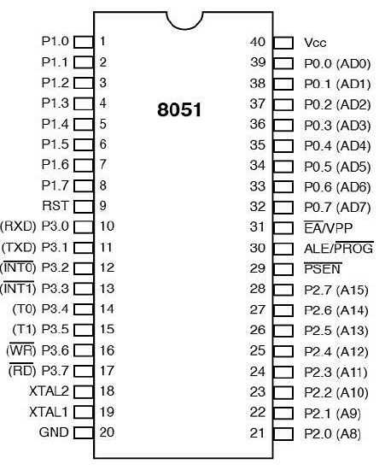
Pin diagram of 80c51
Pin diagram :

Slide 9
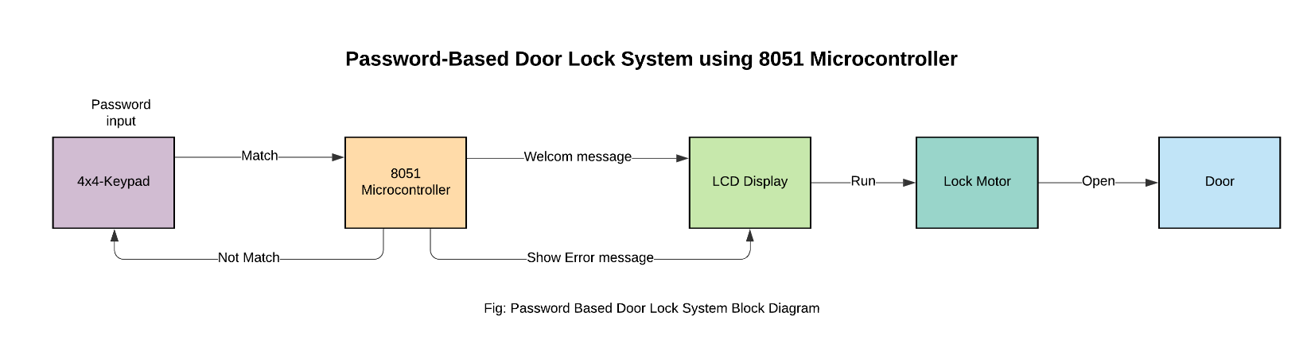
Password-based door lock system
Block diagram:

Slide 10
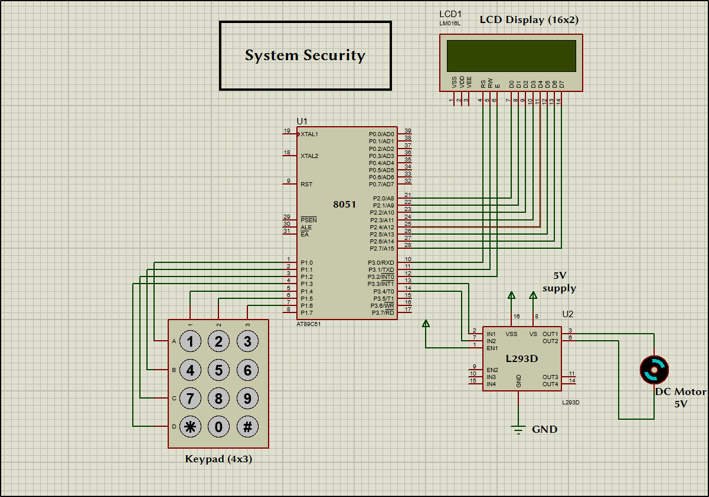
Circuit diagram
System security

Slide 11
Applications
It can be used in a secured door access SYSTEM to protect the door from thefts.
It can be used in residential places, offices, and companies to ensure safety.
Uses in the safes.
It can also be used at organizations to ensure authorized access to highly secured places.

Slide 12
advantages
Circuits require only a few milliamps of current, due to such a low power requirement one can use a small battery to power the system, hence the system is power efficient.
System is portable and can be fixed to any door.
Low cost
Easy to operate as it uses an alphanumeric display.
Password can be changed at any time.

Slide 13
Future scope
The security level can be increased by adding a biometric fingerprint scanner.
We can interface sensors like Fire, LPG, and PIR motion detectors to microcontrollers in case of an accident so that door will open automatically.
We can interface the camera to the microcontroller so that it could capture the picture of the thief who is trying to breach security.
This simple circuit can be used at places like home to ensure better safety. With a slight modification, this project can also be used to control the switching of loads through passwords.

